Slide 1
Part 3
Using IS for
Competitive Advantage
Notes:
In the previous six chapters, you gained a foundation of IS fundamentals. In Chapters 7–12, you will apply those fundamentals to learn how organizations use information
systems to achieve their strategies. Chapters 7–12 are introduced using a cloud-based, mobile application for the healthcare industry. To our knowledge, the system described here does not yet exist. However, it is entirely plausible, may be an excellent entrepreneurial opportunity, and features some of today’s most exciting emerging technology in one of today’s most important industries.

Slide 2
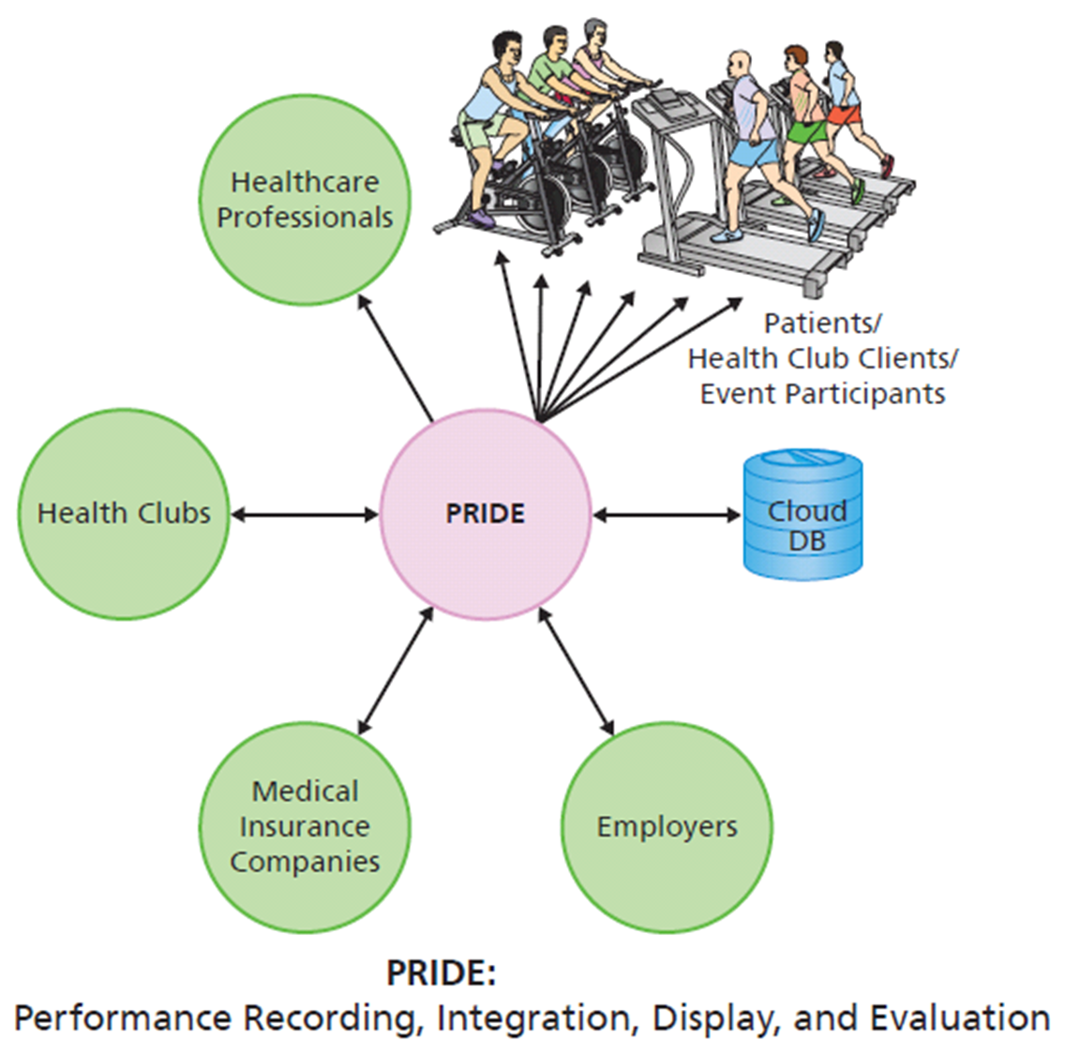
Performance Recording, Integration, Delivery, and Evaluation (PRIDE)
Prototype connections
Written in C# code, runs against an Azure database in the cloud
Notes:
The figure shows the major actors involved in this system. Using PRIDE, exercise workout data is collected from devices that conform to the ANT protocol, which is a personal network communications protocol implemented by exercise equipment. The exercise data is stored in a cloud database.
Once the data is stored in the cloud, individuals, healthcare professionals, health clubs insurance companies, and employers can query and obtain exercise reports.

Slide 3
Performance Recording, Integration, Delivery, and Evaluation (PRIDE) (cont'd)
Prototype developed by cardiac surgeon, Flores, for his use
Helped patients recover
No success in licensing to other doctors
Flores lost interest
Required too much of time
Big financial commitment

Slide 4
Cast of Characters
Zev Friedman bought PRIDE company for a small amount of cash and a royalty agreement
Jared Cooper, new general manager
Nicki Jensen, marketing professional
Michele Russell, sales director
James Wu, technology manager

Slide 5
Why Study the PRIDE Case
Future business professionals need to be able to assess, evaluate, and apply emerging information technology to business
PRIDE system will allow you to practice key skills

